Slide 1


||Jai Sri Gurudev||
Sri Adhichunchanagiri Shikshana Trust®
ADHICHUNCHANAGIRI INSTITUTE OF TECHNOLOGY
(An ISO 9001: 2008 Certified)
Affiliated to Vishvesvaraya Technological University (VTU), Belagavi,
Approved by AICTE, New Delhi, Jyothinagar, Chikkamagaluru-577102
DEPARTMENT OF ARTIFICIAL INTELLIGENCE AND MACHING LEARNING
MINI PROJECT SEMINAR
ON
“HEART DISEASE PREDICTION USING EYE RETINA”
Under the guidance of;
Sathyabhama R B.E, M.Tech.,
Assistant professor,
Dept. of AIML,
AIT, Chikmagalur.
Presented by;
Anushree C B (4AI21AI009)
Keerthana S S (4AI21AI028)
Madhushree N K (4AI21AI032)
6th sem,
Dept. of AIML,
AIT, Chikmagalur.

Slide 2

AGENDA
Abstract
Introduction
Literature Survey
Motivation
Problem Statement
Objectives
Scope of the Project
Hardware and Software Requirements
System Design
Implementation and Algorithms
Results and Snapshots
Conclusion and Future work
References

Slide 3
ABSTRACT
It is necessary to develop a model to predict heart disease occurrence as early as possible with a higher rate of accuracy. Till now the detections are gone through blood tests, ECGs, and invasive stress tests.
Use of csv file can be reaccomplished by retinal images
In this project, heart disease is predicted by a non-invasive method with the retinal image data. A image dataset is considered, as the health of our eyes is connected to the health of our heart. Heart problems can be detected from the changes in the microvasculature, which is imaged from the retina.

Slide 4
INTRODUCTION
Heart disease is one in each of the key causes of to increase in the fatality rate at intervals in the developed world. Therefore, the prediction of heart conditions is unbelievably necessary and up to decrease the fatality rate.
The eyes are often considered windows to overall health, as they can reflect systemic conditions such as diabetes and hypertension. By leveraging retinal images for heart disease prediction, clinicians can adopt a holistic approach to patient care, addressing both ocular and cardiovascular health simultaneously.

Slide 5
The main aim of this study is to predict hypertension, diabetes and hyperlipidemia, which are risk factors for cardiovascular diseases. Heart disease increases the mortality rate in recent years across the world.
Within medical imaging techniques, retinal photography analysis has gained popularity due to its noninvasive and cost-effective nature.
The prediction of unwellness is completed by extracting the choices like the size of blood vessels, non-uniform background illumination, etc. from the retinal image.

Slide 6
LITERATURE SURVEY
SL.NO | AUTHOR | TITLE | PROPOSED METHOD | DRAWBACK
1 | Kelvin Kwakye, E Dadzie. | Machine Learning-Based Classification Algorithms For The Prediction Of Coronary Heart Diseases. | created and tested several machine learning based classification models. The dataset handled unbalanced classes and feature selection. | Slow operation.
2 | Sameer Shaikh, Divya Surve. | Heart disease prediction using eye retinal images | based on the analysis of the predictive models classification performance on combined datasets and the train-test split technique is presented. | Less features considered.

Slide 7
SL NO | AUTHOR | TITLE | PROPOSED METHOD | DRAWBACKS
3 | Sibgha Taqdees. | Heart Disease Prediction | like naive Bayes, k Nearest Neighbour [KNN], Decision tree, Artificial Neural Network [ANN] | Less Accuracy.
4 | Harsit Jindal. | Heart Disease Prediction Using Machine Learning Algorithms. | The strength of proposed model was quiet satisfying and was able to predict evidence of having heart disease in particular individual by using KNN and Logistic Regression which showed good accuracy | Lesser usage of datasets.

Slide 8
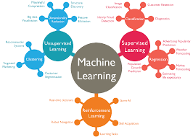
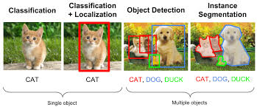

MOTIVATION
Understanding ML Algorithms
Learning Image Processing
Research Advancements

Slide 9
PROBLEM STATEMENT
Develop a heart disease prediction model using high-quality retinal images. Collect and preprocess data by cleaning and augmenting images. Extract features using convolutional neural networks (CNNs). Train and validate deep learning models. Design a scalable, user-friendly interface for medical professionals.
Create a heart disease prediction model using retinal images, featuring data cleaning, CNN-based feature extraction, model training, validation, and a secure, scalable interface.

Slide 10
AIM
The main aim of the proposed method of Heart disease prediction by retinal eye images is to:
INPUT: Collect a dataset of eye retinal images including information on heart disease diagnosis and risk factors.
PREPROCESSING: Pre-process the retinal images to enhance features and ensuring the quality of input data for the predictive model.
    • Noise Reduction
    • Vessel Segmentation
    • Vessel Density and contrast adjustment
    • Bifurcation Points
    • Non-Uniform Background Illumination
OUTPUT: Develop a user-friendly interface for healthcare professionals and others to utilize the trained model for heart disease risk assessment based on retinal images.

Slide 11
objectives
To develop a model that can accurately predict the likelihood of heart disease based on features extracted from eye retinal images.
To revolutionize non-invasive screening methods for cardiovascular health assessment using eye retinal images.
To complement existing diagnostic tools and facilitate early intervention, ultimately leading to improved patient outcomes and reduced healthcare burden associated with heart-related complications.

Slide 12



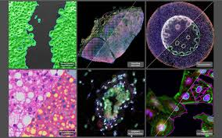
SCOPE OF THE PROJECT
Medical Research and Diagnosis
Image Processing and Analysis

Slide 13


Machine Learning and Data Analysis
Interdisciplinary Collaboration

Slide 14
HARDWARE AND SOFTWARE REQUIREMENTS
SOFTWARE REQUIREMENTS:
• Operating System:Windows, macOS, or Linux
• Programming Languages:Python (machine learning, and deep learning).
• Data Processing: NumPy, Pandas, OpenCV
• Deep Learning: TensorFlow, Keras or PyTorch
• Visualization: Matplotlib, Seaborn
• Integrated Development Environment (IDE):Jupyter Notebook, PyCharm, Co-laboratory
HARDWARE REQUIREMENTS:
• Processor (CPU): Intel i5/i7
• Memory (RAM): Minimum 16 GB RAM 32 GB or more recom-mended
• Graphics Processing Unit (GPU): A dedicated GPU is crucial for deep learning tasks.
• Storage: At least 500 GB SSD for faster read/write
• Display: High-resolution monitor for better visualization

Slide 15
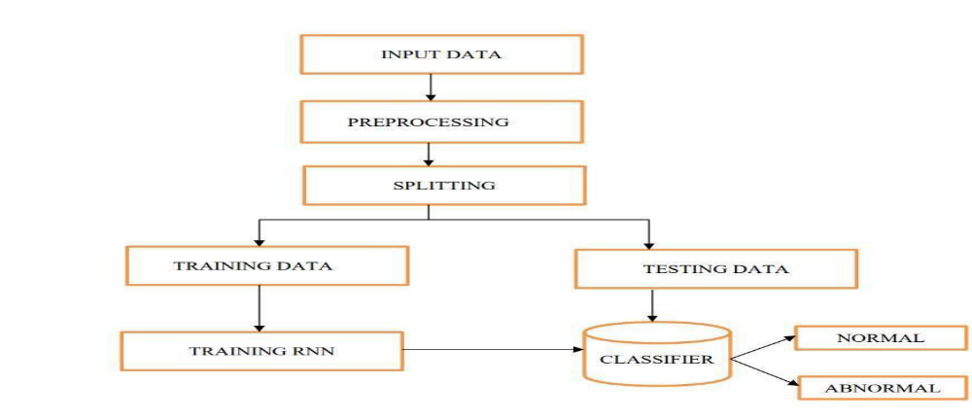
SYSTEM DESIGN
Fig 1: The block diagram for the Heart disease prediction using eye retinal image.

Slide 16
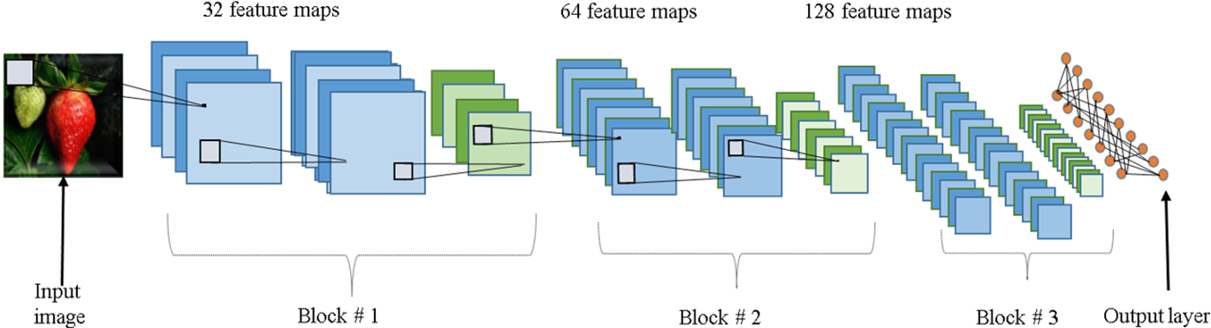
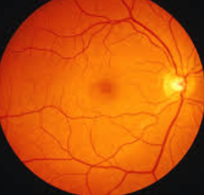
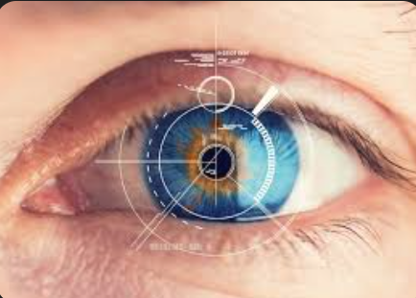
IMPLEMENTATION AND ALGORITHM

Slide 17
PSEUODOCODE FOR CNN
#initialize_cnn()
#add_input_layer(shape=(height, width, channels))
#add_convolutional_layer(filters=32, kernel_size=(3, 3), activation='relu')
#add_pooling_layer(pool_size=(2, 2))
#add_convolutional_layer(filters=64, kernel_size=(3, 3), activation='relu')
#add_pooling_layer(pool_size=(2, 2))
#add_flatten_layer()
#add_dense_layer(units=128, activation='relu')
#add_output_layer(units=num_classes, activation='softmax')
#compile_and_train_cnn(train_data, train_labels, val_data, val_labels, #optimizer='adam', loss='categorical_crossentropy', metrics=['accuracy'], epochs=10, batch_size=32)

Slide 18
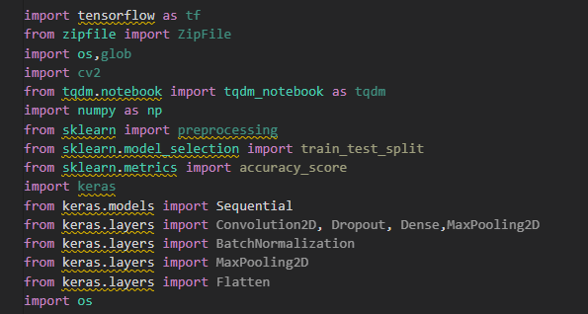
Fig 2: The primary libraries installed

Slide 19
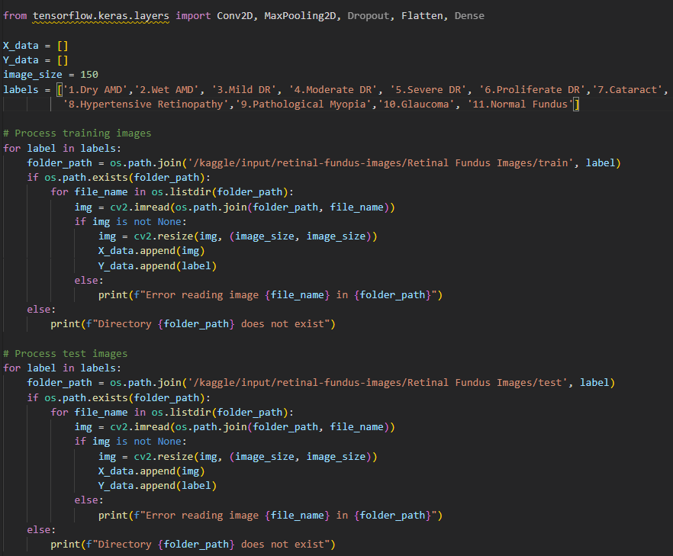
Fig 3: process of training and testing images

Slide 20
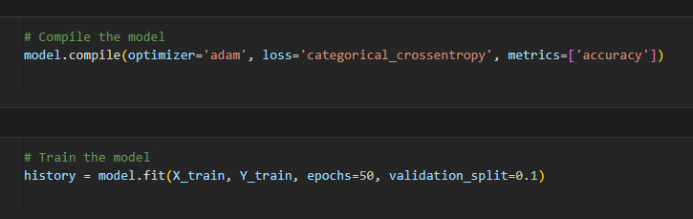
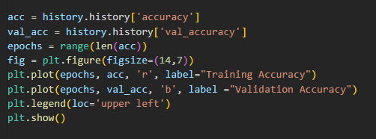
Fig 4: The code for plotting accuracy curve graph

Slide 21
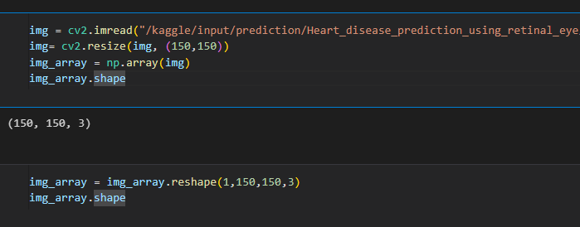
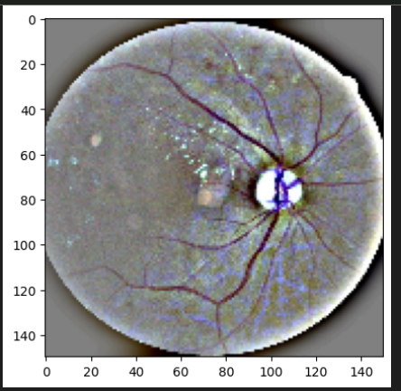
Fig 5: The code of resizing the retinal image

Slide 22
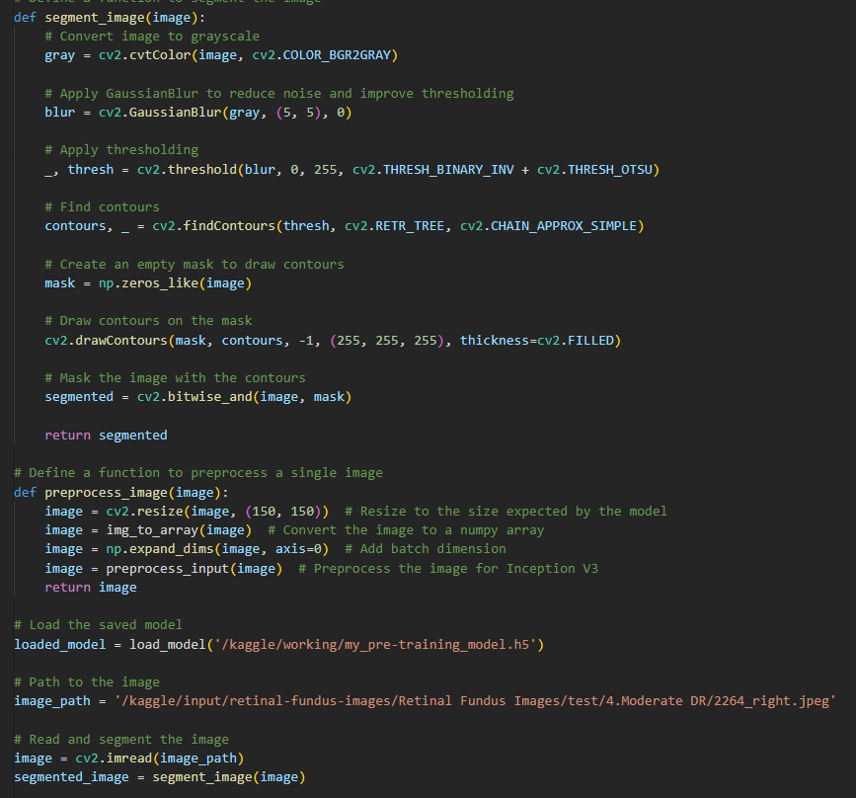
Fig 6: Segmentation using .

Slide 23
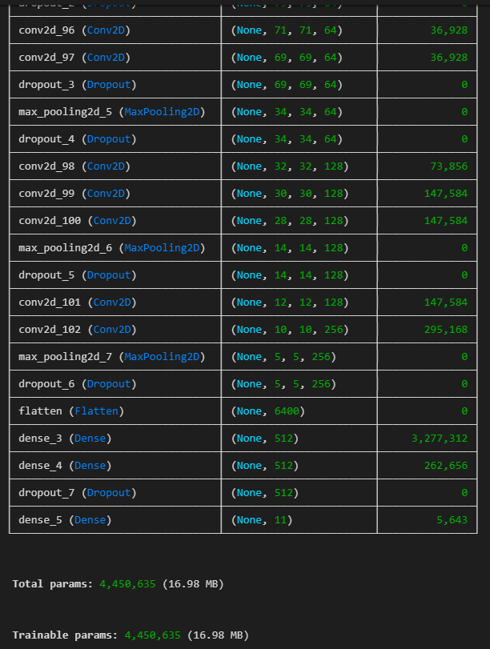
RESULTS AND SNAPSHOTS
Fig 7: parameters considered

Slide 24
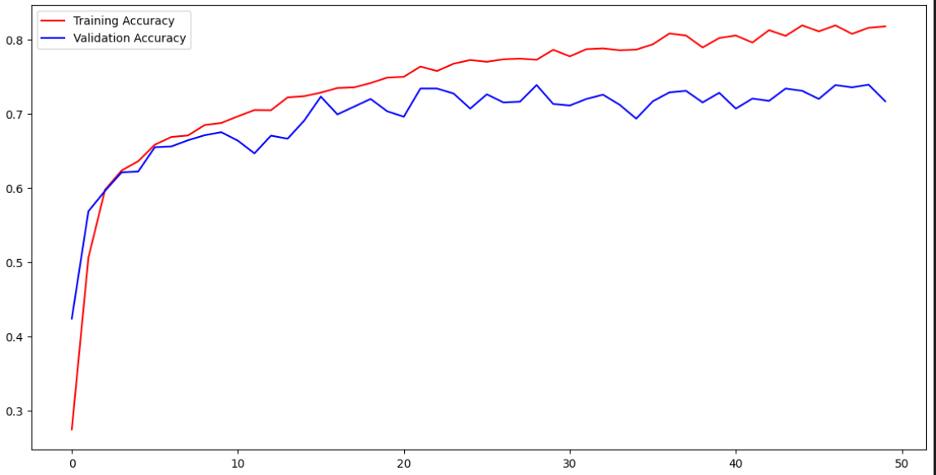
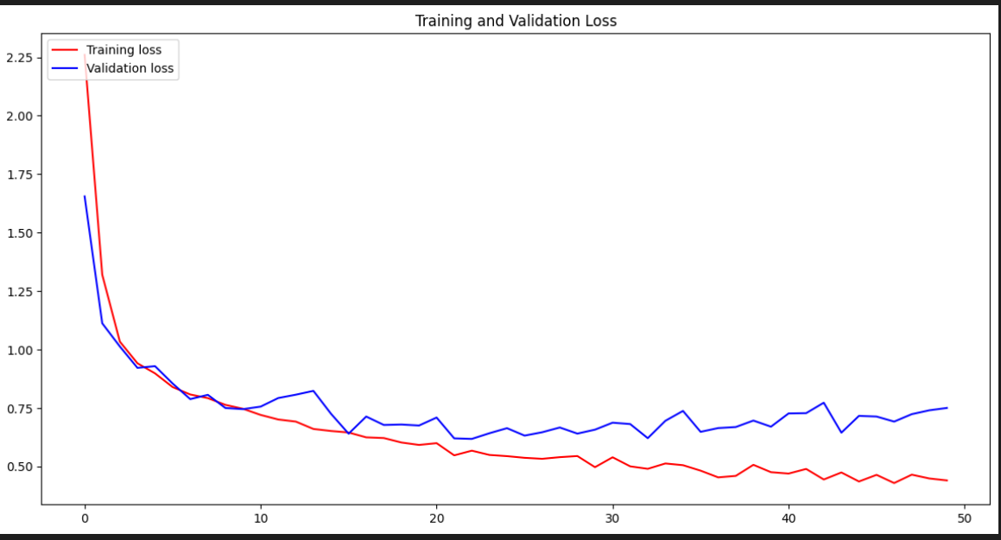
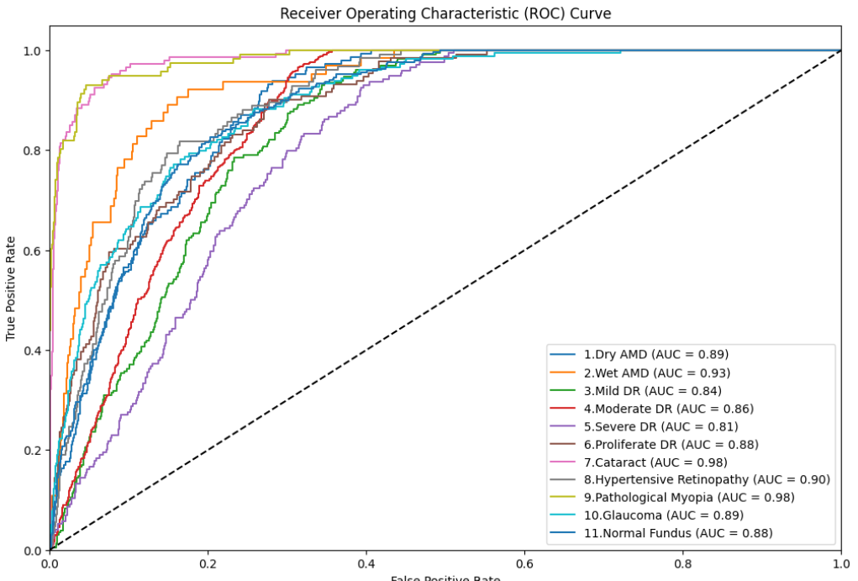
Fig 8: Accuracy curve, Loss curve, ROC curve.

Slide 25
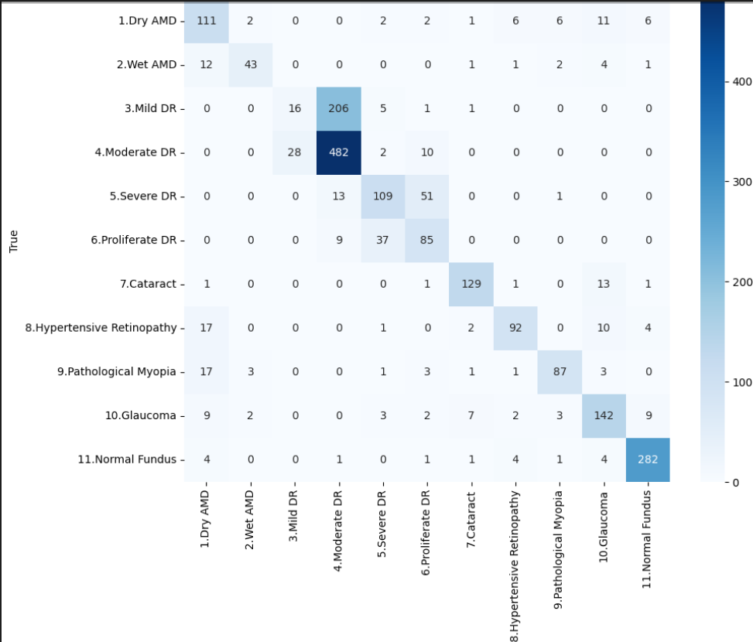
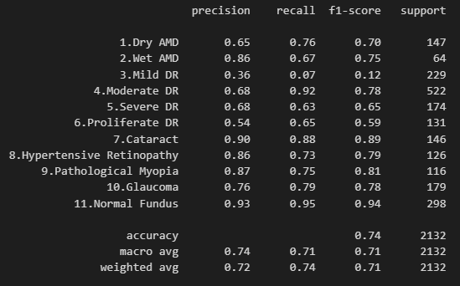
Fig 9: Confusion graph with corresponding values .

Slide 26
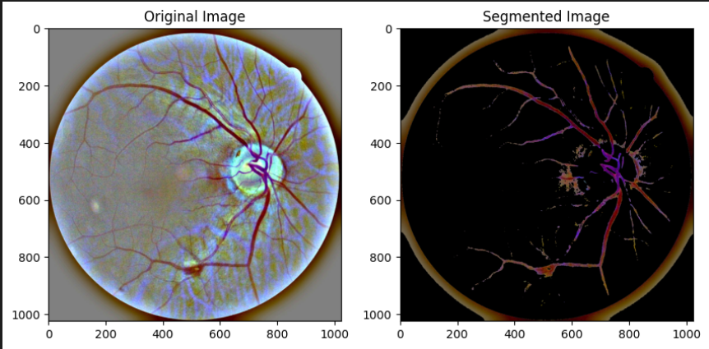
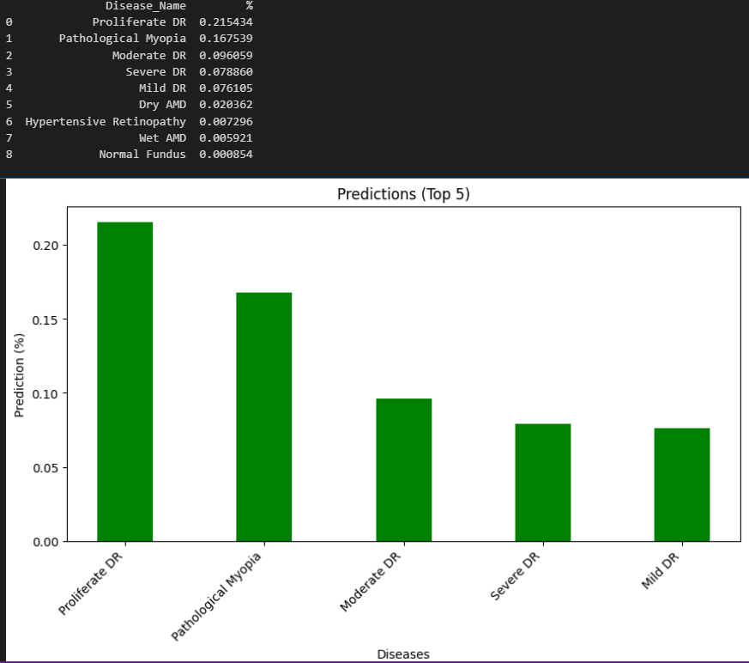
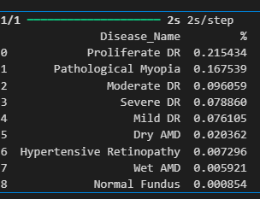
Fig 10: Segmentation of image.

Slide 27
CONCLUSIONS
The results indicated that retinal images can be a valuable source of information for this purpose, showing promising correlations between certain retinal features and indicators of heart disease.
Although the absence of clinical data limits the scope, the analysis demonstrated that specific patterns and abnormalities in retinal images could serve as useful predictors.
This approach offers a non-invasive and accessible method for identifying individuals at risk of heart disease, providing an innovative complement to traditional diagnostic methods.

Slide 28
FUTURE ENHANCEMENTS
Expand Dataset: Increase the number and diversity of retinal images to improve model accuracy and generalizability.
Advanced Algorithms: Experiment with cutting-edge image processing and machine learning techniques to enhance predictive capabilities.
User Feedback: Collect and incorporate feedback from healthcare professionals and users to refine the model and ensure practical relevance.

Slide 29
REFERENCES
[1] P. Melillo, M. Bracale, and L. Pecchia, “For risk assessment in patients a classification tree with congestive heart failure via long-term heart rate variability,” IEEE Journal of Biomedical and Health Informatics, vol. 17, no. 3, pp. 727–733, 2022.
[2] Shurouq Hijazi, Alex Page, Burak Kantarci, Tolga Soyata, ‘Machine Learning in Cardiac Health Monitoring and Decision Support’ Computer , vol. 49, Issue. 11
[3] Zhi, ‘‘Deep learning and its applications in biomedicine,’’ Genomics Proteomics Bioinf., vol. 16, Issue. 23
[4] https://becominghuman.ai/making-a-simple-neural-network-2ea1de81ec20
[5] Heart Disease Prediction Using Eye Retinal Images., 6th International Conference on Advances in Science and Technology (ICAST) ©2023, IEEE 417

Slide 30




